Slide 1
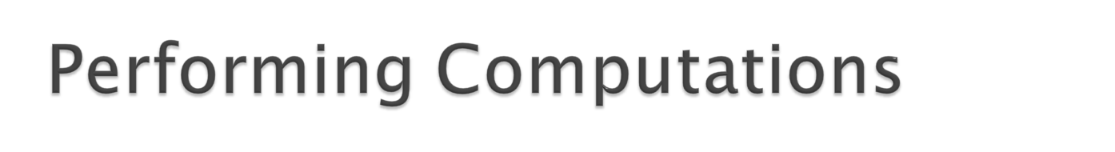
C provides operators that can be applied to calculate expressions:
  example: tax is 8.5% of the total sale
  expression: tax = 0.085 * totalSale
Need to specify what operations are legal, how operators evaluated, etc.
C operations are referred to as Expressions

Slide 2

II. Program Basics
  G. Expressions
    1. Primary
      identifiers, constants, parenthesized expressions
    2. Unary
      postfix: function call, increment, decrement
      prefix: sizeof, unary +, unary -, cast, increment, decrement
    3. Binary
      arithmetic ops: + - * / %
      assignment
      shorthand assignment

Slide 3

II. Program Basics
    4. Casting
      implicit
      promotion hierarchy
      explicit
    5. Side effects
    6. Resolving Expressions
      Precedence
      Associativity
  H. Statements
    1. Expression
    2. Compound

Slide 4
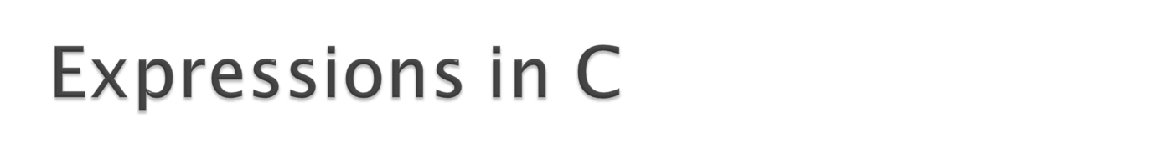
Example: total * TAXRATE
Consists of a sequence of operators and operands
  operands: total, TAXRATE
    can be expressions themselves
  operator: *
    operation calculating a result based on the operand(s)

Slide 5

primary
  expressions that directly map to a value
unary
  prefix: operator operand
  postfix: operand operator
binary
  operand1 operator operand2
ternary (operator in two parts)

Slide 6
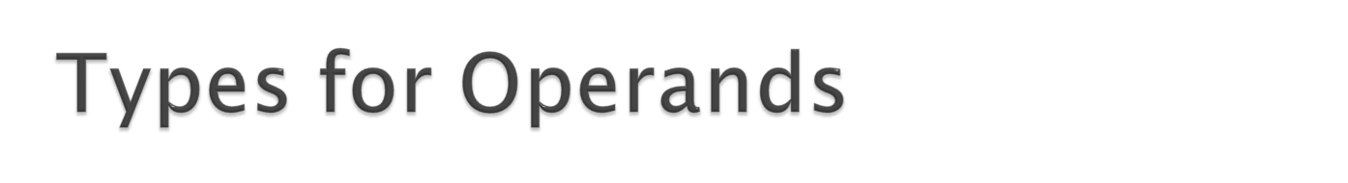
Operators only apply to certain types
  e.g., addition applies to numbers
Each operand must be of the appropriate type
Operators calculate a value
Value can then be used as operands to other operators

Slide 7

identifiers
  variable
  defined constant
literal constants
  operands can be values of the appropriate type
  operator can have constant (e.g., 5, -34) as operand

Slide 8
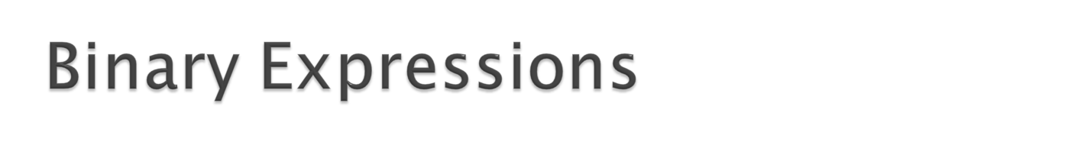
expr1 op expr2
  arithmetic operators
    + - binary addition (e.g., 5 + 3 result: 8)
    - - binary subtraction (e.g., 5 - 3 result: 2)
    * - multiplication (e.g., 5 * 3 result: 15)
    / - division (e.g., 5 / 3 result: 1)
    % - remainder (e.g., 5 % 3 result: 2)
  arithmetic operators apply to number types, result type depends on operand types

Slide 9

  Two int operands -> int result
  Two float operands -> float result
  / - division operator, is whole number division for ints, floating point division for other operands
  % - remainder operator, only works for int values
  Mixed operands (float/int) - result produced is based on a “promotion” hierarchy, result cast to higher type in hierarchy
    e.g., 5 / 3.0 produces 1.666666

Slide 10
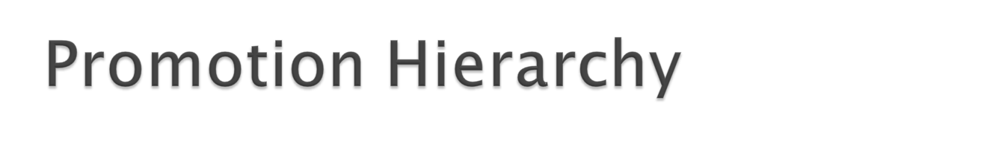
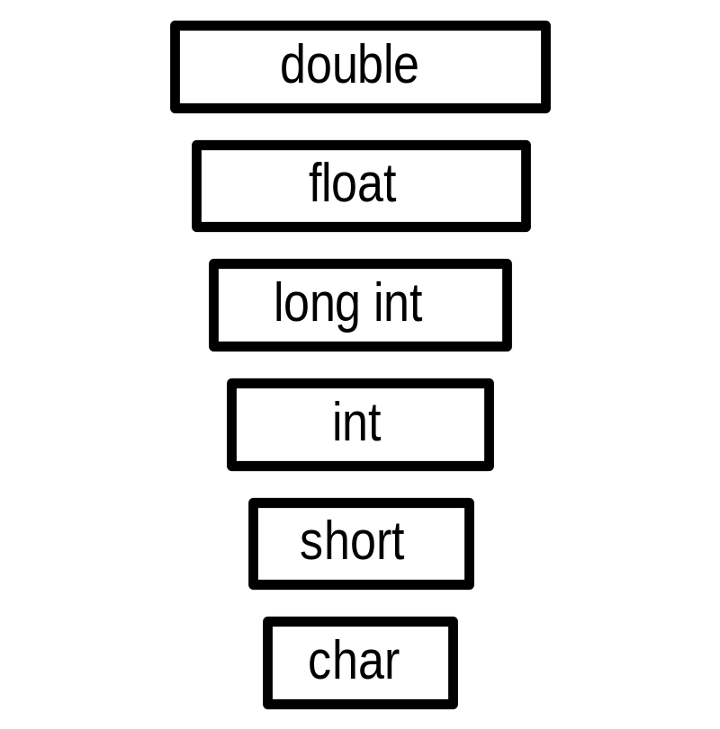
Operands of the lower type can be implicitly converted to the higher type (in C)
Occurs when an operator expects the higher type (adding together two floats when one is an int)

Slide 11
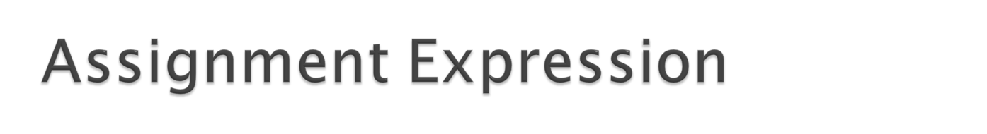
varName = expr
  value of expr determined
  result of expression is the value of expr
  as a “side effect” the value calculated is also stored in the named variable (the current value stored in the variable is replaced)
  example:
    current value of total is 5
    total = 3
    replaces the value 5 with the value 3 in the memory location corresponding to total

Slide 12
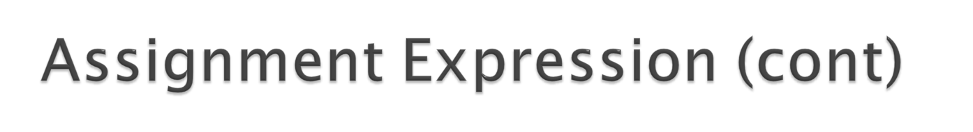
varName = expr
  expr value must be of the proper type to be stored in the variable (error otherwise)
  the value may be converted automatically using the promotion hierarchy
    example:
    float f;
    f = 3; /* 3 cast from an integer to a float value */

Slide 13

+= -= *= /= %=
  example:
    x += 3
  is a shorthand for
    x = x + 3
  assuming x is 7 before x += 3 is calculated, the right-hand side x + 3 is calculated, producing 10, this value is then stored in x, and the result of the expression is 10
  thus, these operators also have side effects

Slide 14

Postfix
  fName(arglist) - function call
    subprogram is called (invoked) which performs some set of computations and returns a value (more later)
Prefix
  sizeof (expr) - expr can be any primary expression or the name of a type, operator returns num bytes used to represent type (int)
  + expr - unary plus (applies to numbers, no effect)
  - expr - unary minus (inverts sign of numbers)

Slide 15
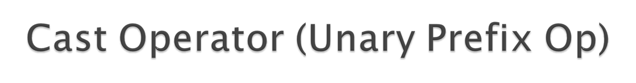
(TypeName) expression
  conversion forces expression value from current type to the provided type
    example: (float) 5 results in 5.0
  especially useful for division
  example:
    totalScore, totalGrades (ints)
    totalScore / totalGrades produces integer
    (float) totalScore / totalGrades casts totalScore to a floating point number, then division occurs

Slide 16

++variable - prefix increment
--variable - prefix decrement
  prefix unary operators
  example: ++x is a shorthand for
  x = x + 1
  similarly --x is a shorthand for x = x - 1
  apply to integral values (char, int)
  have side effect of changing value of variable

Slide 17

variable++ - postfix increment
variable-- - postfix decrement
  postfix unary operators
  similar to prefix versions BUT different in the value they produce
  x++ is a shorthand for the statement x = x + 1 but the result of x++ is the value of x BEFORE the value is changed
  example: assume x is 8, x++ changes x to 9 but returns the value 8
  the postfix decrement operator works similarly

Slide 18
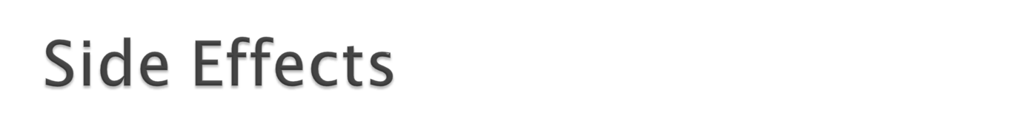
Certain operations not only produce values, but also perform other actions
  assignment statements - change the value of variable on left-hand side of operator
  scanf operator - returns a value (number of arguments read), but also changes variables in scanf expression
    example: scanf(“%d”,&total) changes total

Slide 19

Expressions can be composed to produce more complex expressions
  operand of expression can be an expression:
  total = totalSale + TAXRATE * totalSale
  three operators, =, +, *, how is this expression resolved??
  In C, TAXRATE * totalSale is calculated, then totalSale is added to this value, then this value is stored in total
  But why??

Slide 20

C has precedence, associativity rules it uses to determine the order operators are evaluated in
Precedence: some operators are executed before others
Associativity: when more than one operator in an expression has the same precedence then associativity rules are used to order

Slide 21

  18: Identifier, Constant, Parenthesized Expression
  17: Function call
  16: Postfix increment/decrement,
  15: Prefix increment/decrement, sizeof, unary +, unary -
  14: (Type) - cast operator
  13: * / %
  12: + -
  2: = += -= *= /= %=

Slide 22

Example:
  total = totalSale + TAXRATE * totalSale
  * has highest precedence, so TAXRATE * totalSale is calculated first
  + has next highest precedence, so the result of TAXRATE * totalSale is added to totalSale
  = has the lowest precedence, so the value calculated in the previous operations is stored in total

Slide 23

What if the precedence order is not what you want?
  example: sale1 + sale2 * TAXRATE
  in this case the multiplication would happen first, but you might want the addition first
  answer: parenthesize the expressions you want to happen first
  result: (sale1 + sale2) * TAXRATE
  parenthesized expressions have highest precedence

Slide 24
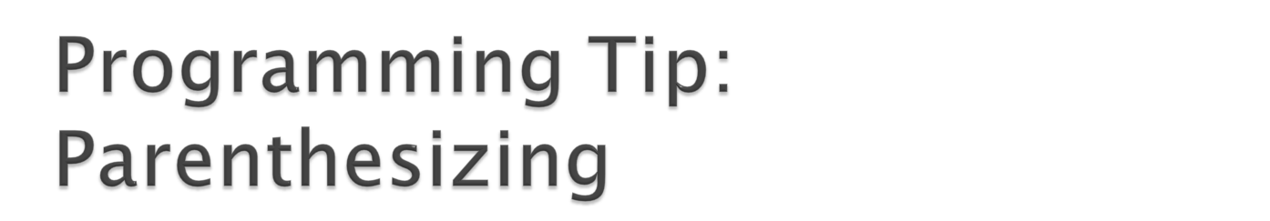
Does not hurt to include parentheses for all expressions
Thus you can guarantee the order of evaluation
  Example:
    total = totalSale + TAXRATE * totalSale
    becomes
    total = (totalSale + (TAXRATE * totalSale))

Slide 25
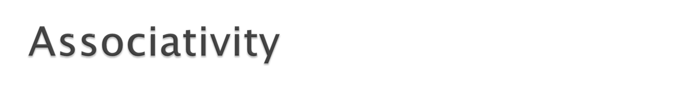
Rules determining how to evaluate expressions containing more than one operator with the same precedence
  example: is 5 - 4 - 3 ((5 - 4) - 3) or (5 - (4 - 3))
  its important because the values may differ (e.g., -2 or 4 for the above possibilities)
Left associativity: operators are evaluated left to right
Right associativity: evaluated right to left

Slide 26

  18: Identifier, Constant, Parenthesized Expression
  17: Function call (LEFT)
  16: Postfix increment/decrement (LEFT)
  15: Prefix increment/decrement, sizeof, unary +, unary - (RIGHT)
  14: (Type) - cast operator (RIGHT)
  13: * / % (LEFT)
  12: + - (LEFT)
  2: = += -= *= /= %= (RIGHT)

Slide 27

Evaluate operators by precedence
When evaluating operators with the same precedence, consult associativity rules
  example: 5 - 4 - 3, two - operators, so associativity (left) is used
  5 - 4 - 3 evaluates to ((5 - 4) - 3) or -2
Again, use parentheses to make sure things are evaluated the way you expect

Slide 28

Example:
  x = y = 3 (x = (y = 3)) with Right associativity
  Ok to do, but better to avoid
Example:
  x is 4, what is the result of x = y = x + 3 ?
  x + 3 evaluated (producing 7), this value stored to y, then the result stored back to x

Slide 29
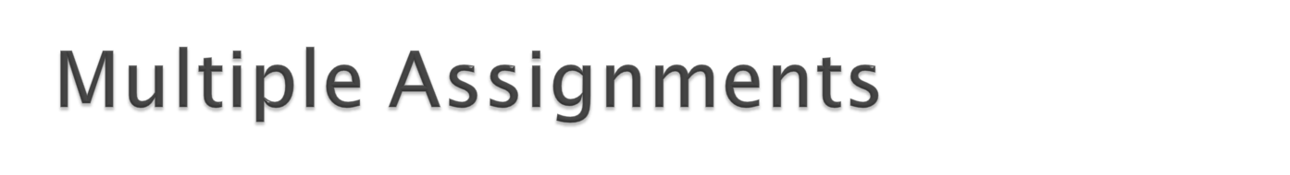
In ANSI C, changing a variable multiple times in the same expression produces an undefined result
  example: (b-- + b--)
  is undefined, C may execute both b-- operators together, the left b-- first, or the right b-- first
  solution: better not to do it

Slide 30
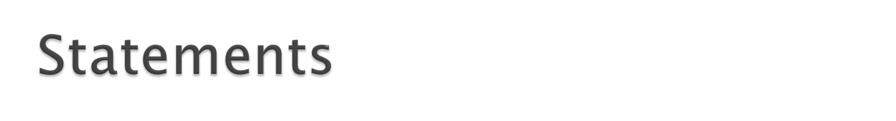
Programs consist of sequences of statements
Expressions can be used as part of various types of statements
Expressions can also be used as stand-alone statements
  generally assignment expressions are issued as separate statements

Slide 31
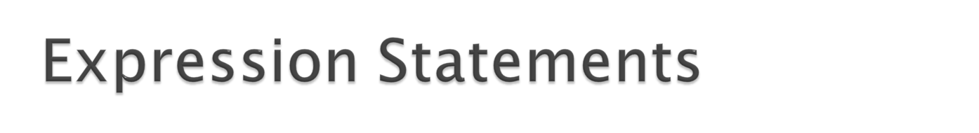
Format: Expression ;
  When the statement is reached in the program the expression is evaluated
  Assignment statements cause side effects (change the value of variables)
  printf and scanf are actually functions that we call (and produce values), so these are expression statements

Slide 32

A block of code containing zero or more statements
Contained between { and }
Format:
  {
  Local Declarations
  Statements
  }

Slide 33

Example:
  {
  int x; /* local declaration */
  x = 3; /* statements */
  y = x + 4;
  printf(“%d\n”,y);
  }
Block of statements treated as a unit

Slide 34
Local declarations exist during the execution of the block/compound statement
Declarations are made one at a time
Statements are executed from the first to the last
Declarations go away once the statements in the block are executed

